Slide 1
Employee Data Analysis using Excel
STUDENT NAME:K.Uma maheshwari
REGISTER NO:312215100
DEPARTMENT:Commerce
COLLEGE:Soka ikeda college

Slide 2
PROJECT TITLE
Employee Performance Analysis using Excel

Slide 3
AGENDA
Problem Statement
Project Overview
End Users
Our Solution and Proposition
Dataset Description
Modelling Approach
Results and Discussion
Conclusion
3/21/2024 Annual Review

Slide 4
PROBLEM STATEMENT
For employee performance analysis
1. For their Achievement
2. For their Increment
3. For their performance tracking
4. For their growth
5. For their personal motivation growth

Slide 5
PROJECT OVERVIEW
Analysis the performance of employee consider various factors like performance score, Gender, Ratings, Achievements analysis. Employee to find trends and patterns performance different on high, medium, low categories of employee.
.

Slide 6
WHO ARE THE END USERS?
1. The End User is Employee
2. The End User is Employer
3. The End User is Manager
4.The End User is Financial Support

Slide 7
OUR SOLUTION AND ITS VALUE PROPOSITION
*Conditional formatting* - It is used for Highlight the missing values.
*Filter* - To remove the missing values/filtering out
*Formula*- It analysis the performance the employee analysis
*Pivot table* - It is summary of employee performance
*Graph*- To represent the data visualization through graphs or bar chart .

Slide 8
Dataset Description
EMPLOYEE DATA SET - DOWNLOAD From the Edunet dashboard. They are 26 features of employees. 1. Employee ID- Unique identifier for each employee in organization. 2. First Name - The first name of the employee 3. Last Name - The last name of the employee 4. Start Name - The Data when the employee started the working in organization. 5. Exist Date - The data when the employee left the organization. 6. Title - The job title or position of the employee within the organization 7. Supervisor - The name of the employee immediately supervision or manager. 8. Email - The email address associated with employee communication within the organization. 9. Business unit - The specific business unit or department to which employee belongs.

Slide 9
THE "WOW" IN OUR SOLUTION
PERFORMANCE LEVEL = IFS(Z8>=5, VERY HIGH, Z8>=4, HIGH,Z8>=3, MEDIUM, TRUE, LOW.
3/21/2024 Annual Review
9

Slide 10
MODELLING
Data collection 1. Download the employee data in the edunet dash board FEATURES 1. It is very useful to analysis the data sets 2. It is analysis the performance the employees. DATA CLEANING 1. To identify the missing values 2. To identify the missing values and filter out PERFORMANCE LEVEL 1. Conditional formatting it is used to high light the missing values 2. FILTER it is used to remove the missing value /filter out it SUMMARY 1. IT Is used to find the employee id 2. The first name and last name of the employee 3. It is verify the performance of employee 4. It verify the gender, employee ratings, achievements.
10

Slide 11
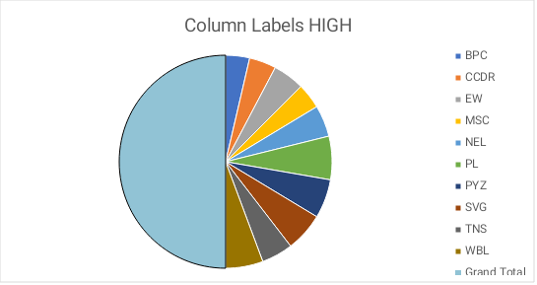
RESULTS
11

Slide 12
conclusion
In this employee data we have many data sets have analysis through charts, bar charts etc. We have known the employee data performance like performance score, gender, ratings employee achievement like high, medium, low.

